Slide 1
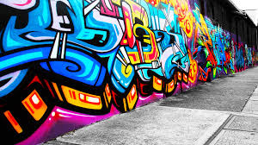
STREET ART
AND SOCIAL CHANGE

Slide 2
WHY STREET ART?
Why do artists take to the street?

Slide 3
Is art a crime?
When does it stop being “art” and start being vandalism?

Slide 4
What has street art done for us?
How has street art influenced change?

Slide 5
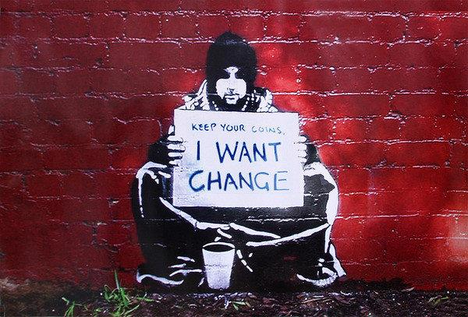
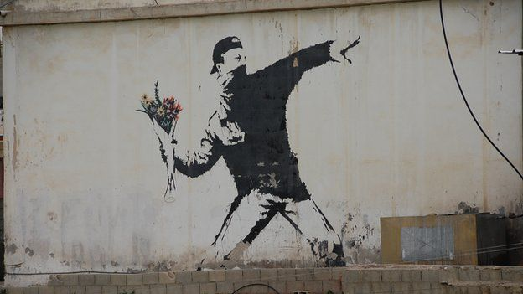
Banksy

Slide 6
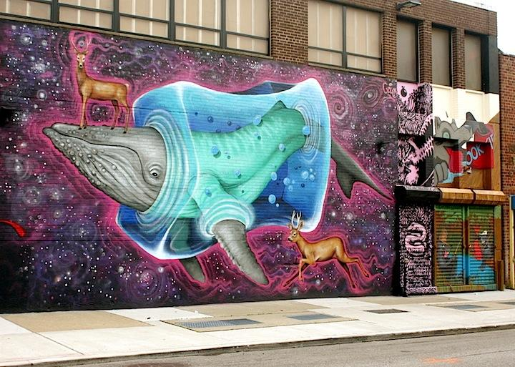
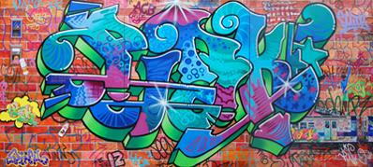
Lady Pink (Sandra Fabara)

Slide 7
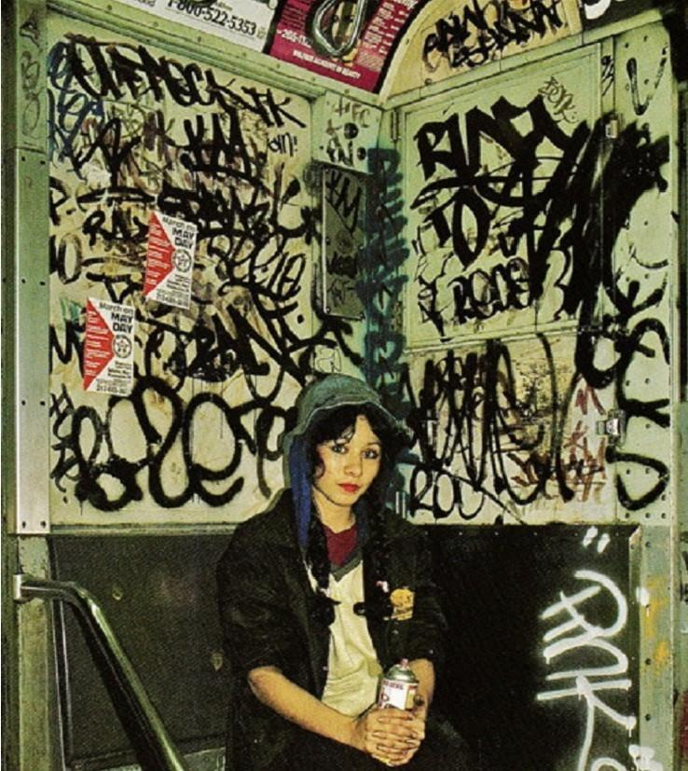
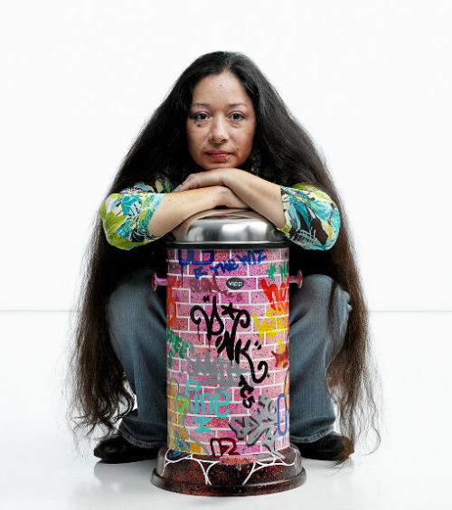

Slide 8
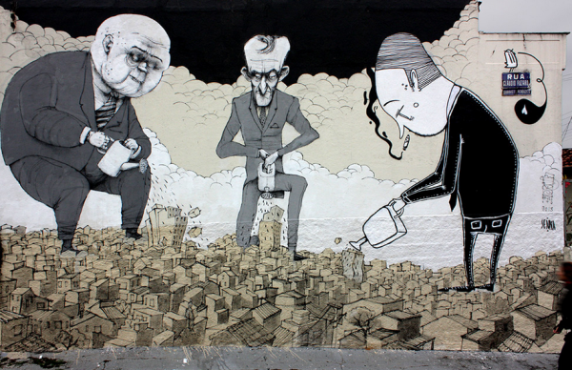
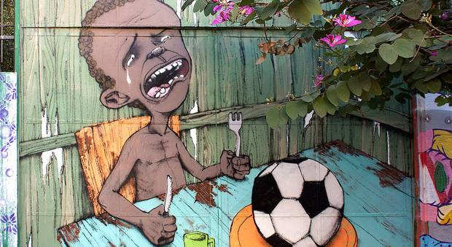

Slide 10
Your Own Design - 4th period
Planning sheet - Due 4/13 (wednesday)
Initial design in pencil - Due 4/19 (Tuesday)
Full color drawing -

